Slide 1


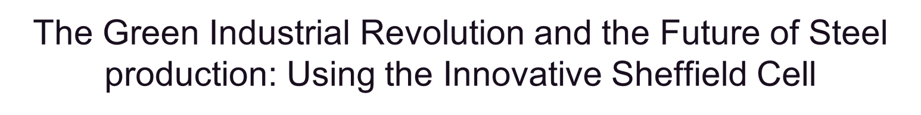
Daniel s Harris

Slide 2
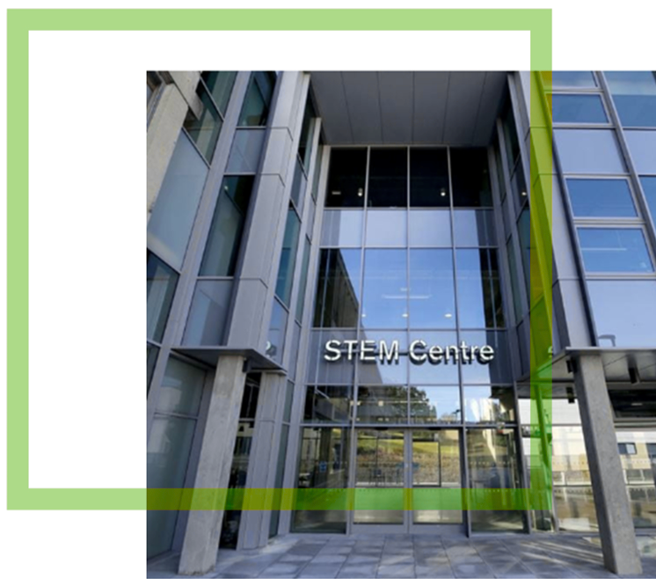
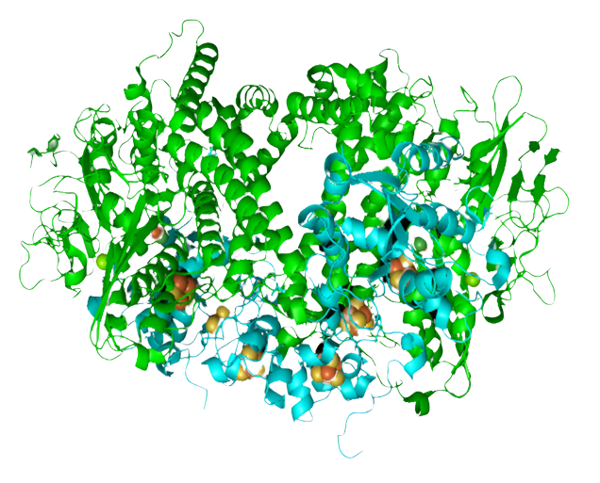

An open space for Innovation
Image taken from Facilities in the Faculty of Science and Health | University of Essex

Slide 3
Why?
•The British steel industry represented 26% of total UK greenhouse gas emissions in 2021 from manufacturing
•The 3rd largest industrial emitter of CO2 due to high energy consumption
Ambrosio-Albalá et al., 2023), (Knight and Walker, 2022).
Therefore…….
‘Reducing energy consumption and CO2 emitted in the steel industry must be at the forefront if our nation is to become carbon neutral by 2050’

Slide 4
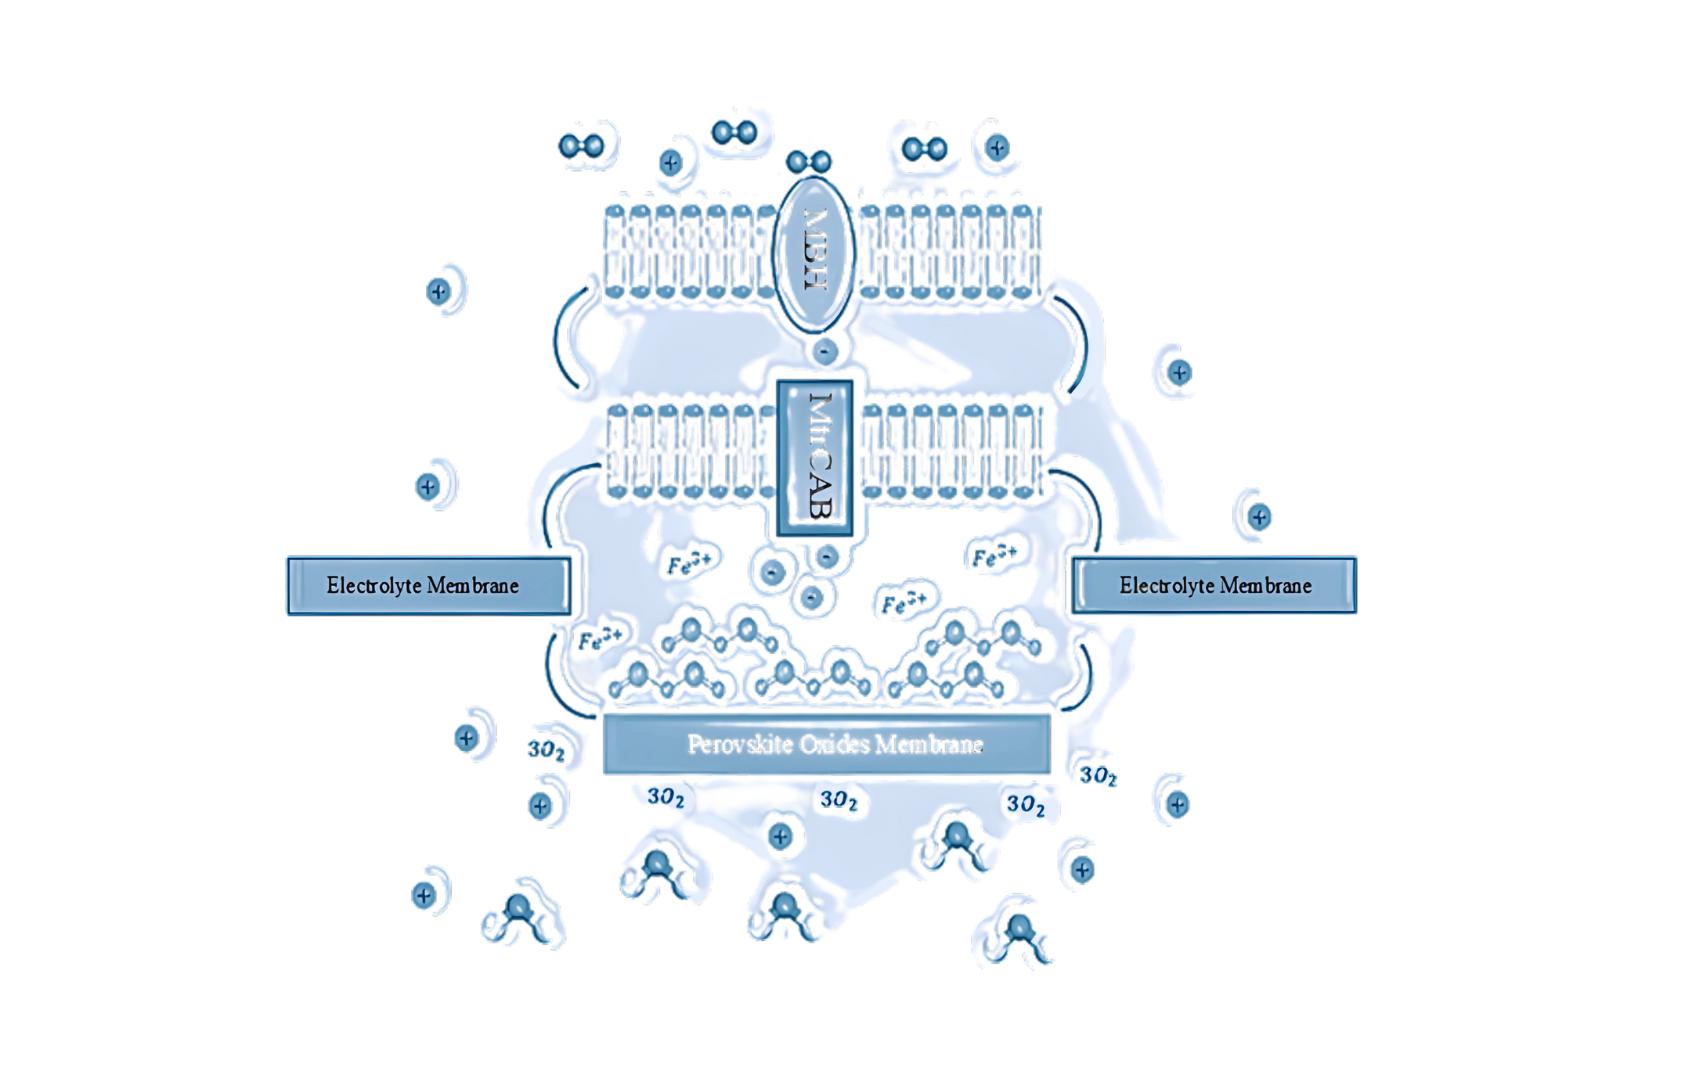
How?
  Proximal [4Fe-3S] coordinated by 6 cysteine residues, Cys 149,120,115,17, 19, 20
  [Ni-Fe] complex bound to dihydrogen = distorted unfavourable square planer conformation - near 90-degree bond angle
  Expulsion of protons from HoxG via the 𝑀𝑔2+ pathway has commenced - electrons pass into the small sub-unit HoxK
  The MtrA unit is situated within the periplasmic region harbouring the decaheme c-type cytochrome matrix
  MtrB beta barrel conformation, further encased in the outer membrane
  MtrC protrudes into the outer membrane, hosting the terminal decaheme c-type cytochrome complex

Slide 5


Where has Essex taken me ?

Slide 6


  A fully funded trip to the ICC Birmingham
  Presented a scientific poster
  Gave a student flash talk

Slide 7
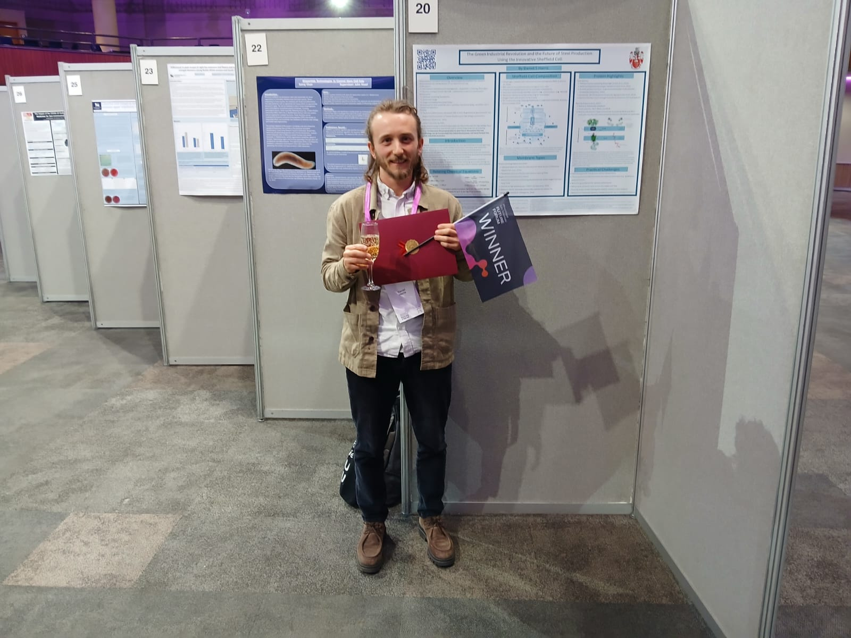
  A fully funded trip to the ICC Birmingham
  Present a scientific post
  Give a student flash talk

Slide 8









Having published work with the Essex student journal aided me in

Slide 9


Having published work with the Essex student journal aided me in

Slide 10

An Essex publication
  Increased my exposure
  Enhanced my experience
  Enriched my academic life
  Helped with my future applications

Slide 11
Thank you

