Slide 1
Is Middle English a Koiné Language?
With Llinos Evans

Slide 2
Ic þa wiht geseah
Can you read this?
Taken from the Exeter Book (Baum 1963; Krapp and Dobbie 1936)

Slide 3
I saw the thing
Can you read this?
Taken from the Exeter Book (Baum 1963; Krapp and Dobbie 1936)

Slide 4
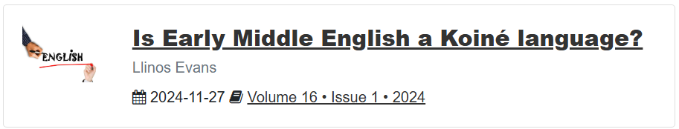
A sight most profounde…

Slide 5
About me!
I am a 1st year student studying Teaching English as a Foreign Language, hoping to teach in China.
During my Foundation Year, I wrote this paper, and...now I’m here!
Today, I want to show you how I got to my conclusion, and further research I conducted.

Slide 6
Þis is Æld Ænglisc
Sigon þā tō slǣpe. Sum sāre angeald
ǣfen‐ræste, swā him ful‐oft gelamp,
siððan gold‐sele Grendel warode,
unriht æfnde, oð þæt ende becwōm,
swylt æfter synnum. Þæt gesȳne wearð,
wīd‐cūð werum, þætte wrecend þā gȳt
lifde æfter lāðum, lange þrāge
æfter gūð‐ceare; Grendles mōdor,
ides āglǣc‐wīf yrmðe gemunde,
sē þe wæter‐egesan wunian scolde.
Beowulf, c.700-1000 A.D.
Chickering, 2006, v.1250-1260.

Slide 7
A þing unliche...
Anno. 455: Her Hengest and Horsa fuhton wið Wyrtgerne þam cininge on þære stowe þe is cweden .Ægeles þrep. and his broðor Horsan man of sloh. and æfter þonn feng to rice Hengest. and Æsc his sunu.
Anno. 456: Her Hengest and Æsc gefuhton wið Bryttas on þere stow þe is ge cweden Crecgan ford, and þer of slogon iiii werad. and þa Bryttas forleton þa Kentland. and mid mycclum ege flugon to Lunden byrig.
The Peterborough Chronicle, (Ælfrǣd Micela 1100)
Wikisource Archive

Slide 8
By what wey ben we hider ycome?
Whan that knight had thus his tale ytoold,
In all the route nas ther yong ne oold,
That he ne seyde it was a noble storie,
And worthy for to drawen to memorie;
And namely the gentils everichon.
Oure Hooste lough and swoor, “So moot I gon,”
This gooth aright; unbokeled is the male.
Lat se now who shal telle another tale;
For treewly the game is wel bigonne.
The Canterbury Tales, c.1100
(Chaucer 2020:The Miller’s Prologue, v.3109-3118)

Slide 9
Myn profer: A Koiné theorie of Englisch
A koiné is the coming-together of multiple intelligible languages or dialects. The name comes from Koiné Greek.
Language contact is the main process that drives their creation, usually sudden migration.
Grammatical systems do not collapse but may simplify.
Vocabularies usually increase, so synonyms may arise.
Some modern examples include Mandarin Chinese, Modern Hebrew, and Taiwanese Hokkien (Siegel, 1985; Coblin, 2000; Wan, 2022).

Slide 10
What formeth a Koiné?
Siegel’s (1985) criteria for a koiné to form are as follows:
The languages or dialects must be either closely related or mutually intelligible.
The languages or dialects must be of equal prestige.
No outside language exists to serve as a link.
I argued, building on research set out by Tydings (2021), that these conditions were met with regards to the Peterborough Chronicle, circa 1100, which would be considered “Early Middle English”.
We know Middle English changed a lot: We just don’t know how to categorise it.

Slide 11
Gunnlaugs saga ormstungu
In Chapter 7 of Gunnslaugs ornu stugu (c.1280), there was a particular quote:
Þá réð fyrir Englandi Aðalráðr konungr Játgeirsson ok var góðr höfðingi. Hann sat þenna vetr í Lundúnaborg. Ein var þá tunga á Englandi sem í Nóregi ok í Danmörku. En þá skiptust tungur í Englandi, er Vilhjálmr bastarðr vann England. Gekk þaðan af í Englandi valska, er hann var þaðan ættaðr.
Now at that time King Ethelred, the son of Edgar, ruled over England, and was a good lord; this winter he sat in London. But in those days there was the same tongue in England as in Norway and Denmark; but the tongues changed when William the Bastard won England, for thenceforward French went current there, for he was of French kin (Magnússon & Morris, 1901).

Slide 12
The First Grammatical Treatise
In The First Grammatical Treatise (1280), the writer notes…
En þó ríta enskir menn ensku na látínustǫfum, ǫllum þeim er réttræðir verða í enskunni, en þar er þeir vinnask eigi til, þá hafa þeir við aðra stafi, svá marga ok þesskonar sem þarf, en hina taka þeir ór, er eigi eru réttræðir í máli þeira. Nú eptir þeira dœmum, alls vér erum einnar tungu…
Crawford (2021) translates this as a claim that the Icelandic, Danish, and English peoples were “of the same language,” arguing for the Icelandic people to adopt similar spelling reforms.

Slide 13
Þe Danelaw
The Treaty of Alfred & Guthrum (c.890) instated the Danelaw, an area where the Danes would reside.
The laws in the treaty were written completely in Old English, yet targeted the Danes. It was also a trade agreement, saying hostages should be kept to promote “peaceful behaviour (Attenborough, 1922; Lavelle, 2010).
This place eventually became Yorkshire, a place with a dialect still filled with Norse words such as garth (of which has many derivative words) today (Rhodes, 2015).

Slide 14
ᚠᚢᚦᚩᚱᚳ
ᚠᚢᚦᚩᚱᚳᚷᚹᚻᚾᛁᛡᛇᛈᛉᛋᛏᛒᛖᛗᛚᛝᛟᛞᚪᚫᛠᚣ
The Norse and English used the same writing system, known in Old English as futhorc (ᚠᚢᚦᚩᚱᚳ).
The rune poem used was almost identical to Norse ones.
Following Christian influence in the 7th Century, it coexisted with the Latin alphabet for some time before fading away (Halsall 1981).
Futhorc featured Nordic religious and cultural connotations, with ᛝ representing Freyr, and ᚢ representing the Aurochs that Europeans hunted, for example.

Slide 15
Þe moost yused wordes in Englisch ben of Norse!
The first-documented Norse word in English is “kalla,” in the year 900 (Jesperson, 1968). Others include bag, bat, bait, bark, feed, cut, cow, fry, gag, gasp, gush, spike, winter, borough, and so many more.
“Hustings”, the political term, is Nordic in nature: They pioneered the idea of government.
The words “they,” “them”, and “their”? Old Norse. The original words were hīe and heora. This process is, linguistically, extremely rare.

Slide 16
A Matere of Cultur
So, we have an environment where…
Two groups of people “of the same tongue.”
The groups have deeply similar cultural roots.
Ample trade was taking place.
This lays the groundwork for koineisation of the “dialects” of Norse the people believed there was.
I argue that Early Middle English koineised prior to French influence, around the 12th Century.

Slide 17
To make an ende…
I am not an expert – I am merely an English teacher.
My argument is difficult to linguistically prove due to very few sources dating back to the 12th Century.
Should I pursue historical linguistics in the future, I would probably build on this further.

Slide 18
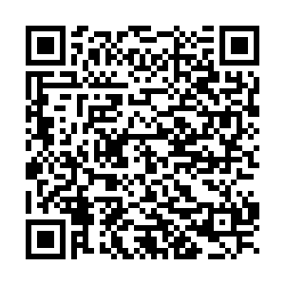
ᚦᚫᛝᛣ᛫ᛄᚢ
The reference list is very long but very interesting, so please click this!

