Slide 1










The intention underneath
Can the motor system ascribe intentions?
By Juliana Guerra

Slide 2

Table of contents:
About Me
Introduction
Iacoboni et al ( 2005 ) experiment Bonini et al ( 2010 ) study
Hickok and Sinigaglia’ s ( 2013 ) example Recent papers
Conclusion

Slide 3





About Me
Federal University of Bahia (Universidade Federal da Bahia - UFBA) Research projects
Neuropsychology

Slide 4
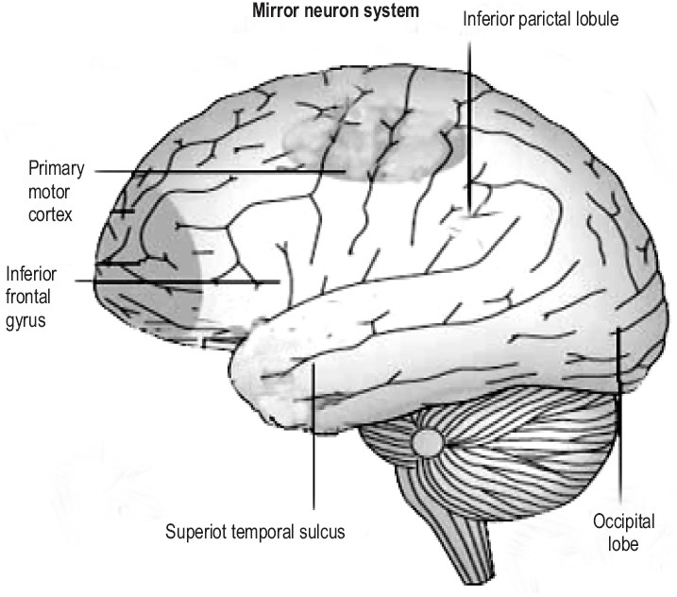
Introduction
Mirror neurons
Discovered in macaques
Areas in humans
( Rajmohan & Mohandas, 2007 )

Slide 5
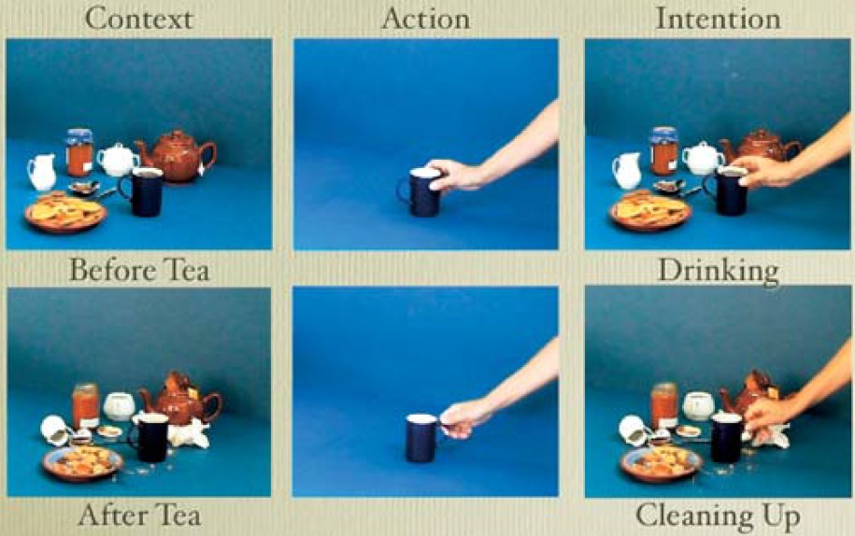
Iacoboni et al (2005) experiment
To grasp a cup (clean or drink
+ fRMI)
Direct matching hypothesis

Slide 6

Iacoboni et al (2005) experiment
Likely goal encoding, but not driven by stimulation

Slide 7


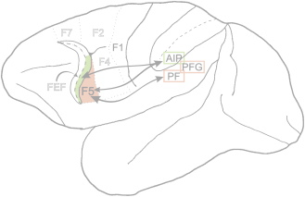
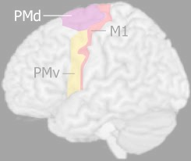


Bonini et al (2010) study
F5 motor neurons ➞ grasping of action if coded differently depending on the context
PMv neurons ➞ part of a functional circuit underlying others’ intention understanding
(Craighero et al, 2007)
(Chouinard, 2006)

Slide 8
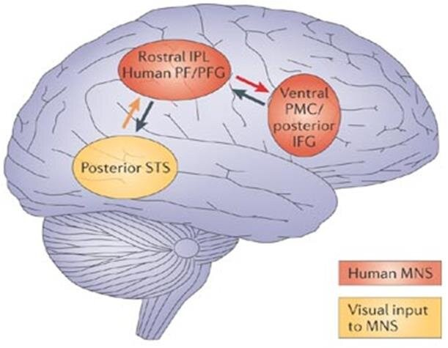
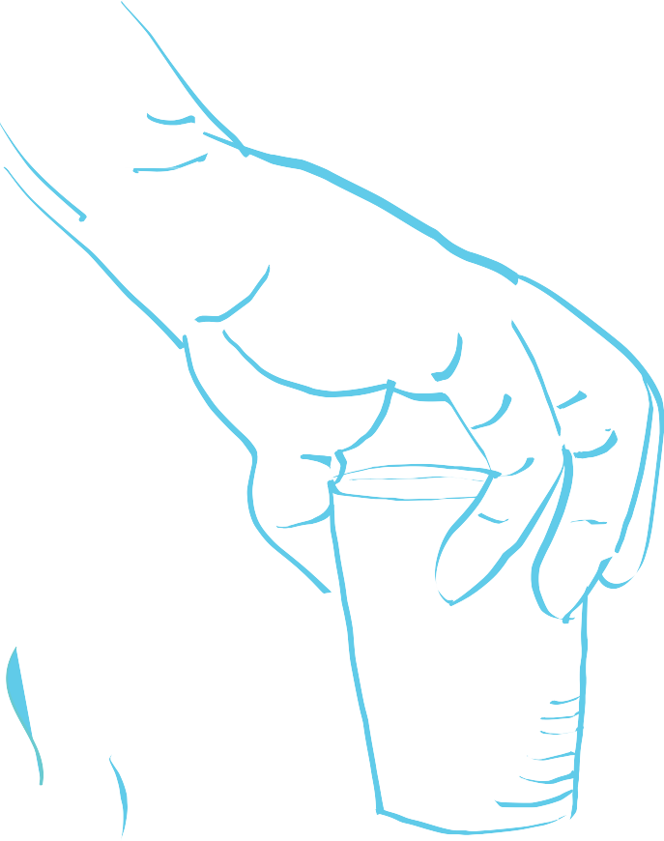


Hickok and Sinigaglia’s (2013) example
(Krol, 2017)
Parieto-frontal mirror mechanism

Slide 9


R e c e n t p a p e r s
HEYES AND CATMUR ( 2022 )
Young human infants develop imitation relying on general, unrestricted associative learning
HUANG, ET AL. ( 2024 )
Kinematic information

Slide 10

Conclusion
Mirror neurons identify actions
Action understanding involves a chain of events linked to developmental factors and social stimuli
It requires context

Slide 11



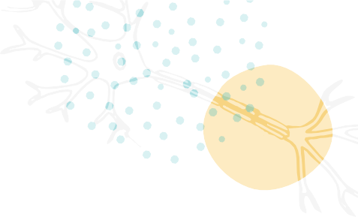
References
Bonini, L. , Rozzi, S., Serventi, F. U., Simone, L. , Ferrari, P. F. and Fogassi, L. ( 2010 ) . ‘ Ventral Premotor and Inferior Parietal Cortices Make Distinct Contribution to Action Organization and Intention Understanding’. Cerebral Cortex, 20 ( 6 ) . 1372 - 1385 . https://doi .org /10.1093/cercor/bhp200
Chouinard, P. ( 2006 ) ‘ Different Roles of PMv and PMd during Object Lifting’ Journal of Neuroscience, 26 ( 24 ) 6397 - 6398 ; https:// doi. org/ 10 . 1523 / JNEUROSCI. 1481 - 06 . 2006
Craighero, L. , Metta, G., Sandini, G. and Fadiga, L. ( 2007 ) . ‘ The mirror- neurons system: data and models’. Progress in Brain Research, Volume 164 , P. 39 - 59 . https:// doi. org/ 10 . 1016 / S 0079 - 6123 ( 07 ) 64003 - 5
Heyes, C. and Catmur, C. ( 2022 ) . ‘ What Happened to Mirror Neurons?’ Perspectives on Psychological Science, 17 ( 1 ) 153 – 168 . https://doi.org/10.1177/1745691621990638
Hickok, G. and Sinigaglia C. ( 2013 ) ‘ Clarifying the role of the mirror system’. Neuroscience Letters, 540 , 62 – 66 . https://doi.org/10.1016/j.neulet.2012.11.029
Huang, L. , Du, F., Huang, W., Ren, H., Qiu, W., Zhang, J. , Wang, Y. ( 2024 ) ‘ Three- stage Dynamic Brain- cognitive Model of Understanding Action Intention Displayed by Human Body Movements’ Brain Topography , 37 , 1055 – 1067 . https://doi.org/10.1007/s10548-024-01061-3
Iacoboni, M., Molnar- Szakacs, I . , Gallese, V., Buccino, G., , Mazziotta, J. C. and Rizzolatti, G. ( 2005 ) . ‘ Grasping the Intentions of Others with One’ s Own Mirror Neuron System’ PLo S Biology, 3 ( 3 ) , 0529 - 0535 . https://doi.org/10.1371/journal.pbio.0030079
Krol, M. ( 2017 ) . ‘ Dynamics of cortical oscillations related to anticipating and observing actions in
individuals with and without autism spectrum disorders’. Ph D thesis. University of Hull.
Rajmohan, V. and Mohandas, E. ( 2007 ) . ‘ Mirror neuron system’ Indian J Psychiatry 49 ( 1 ) , 10.4103/0019-5545.31522
66 – 69 . doi:

Slide 12
Thank you for your attention!
Questions?

