Slide 1
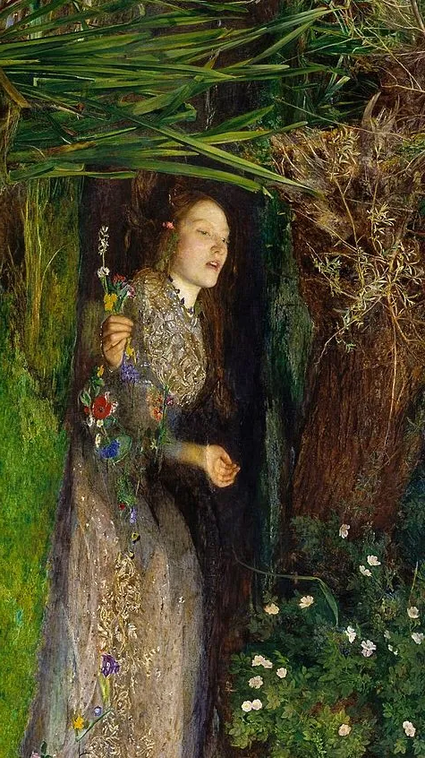
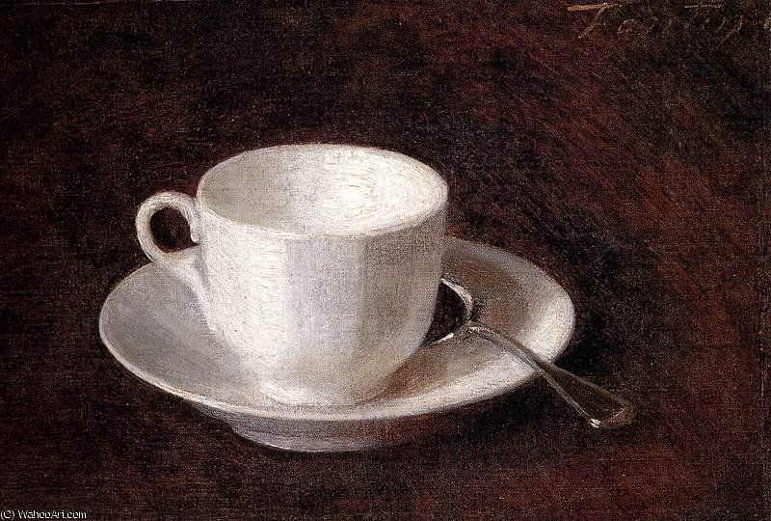
Experiments in Equations and Other Angles
?

Slide 2
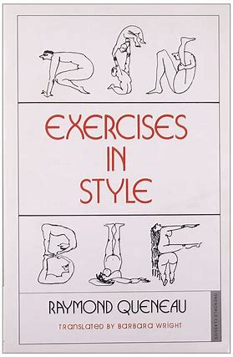
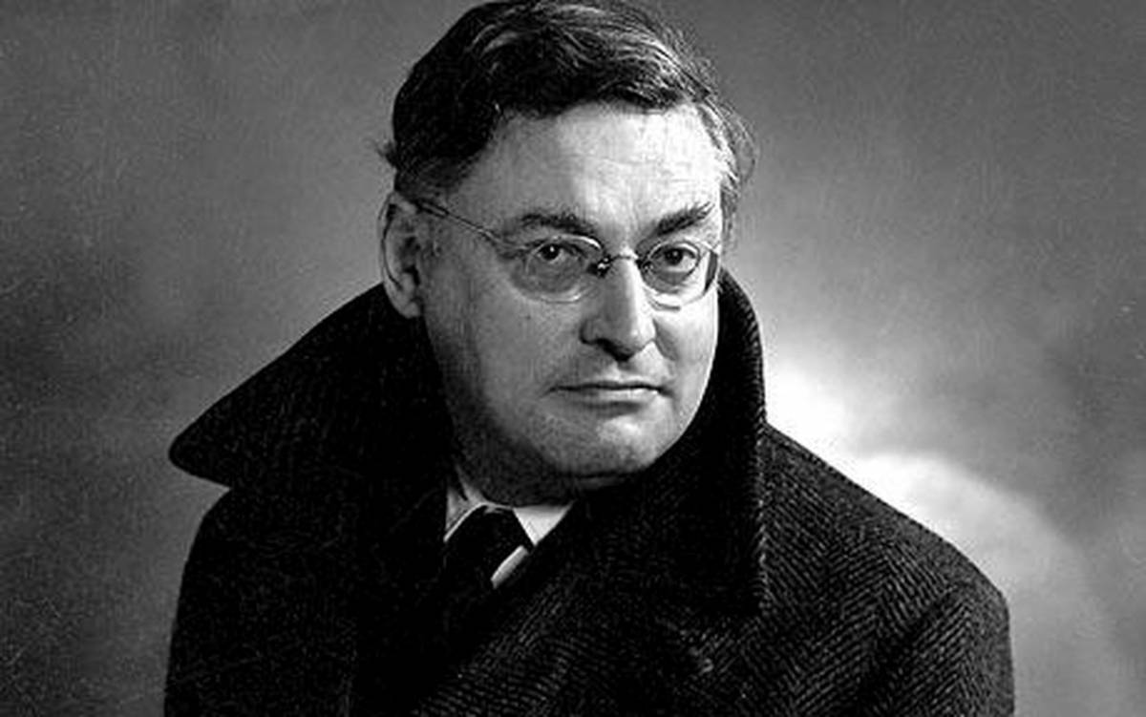
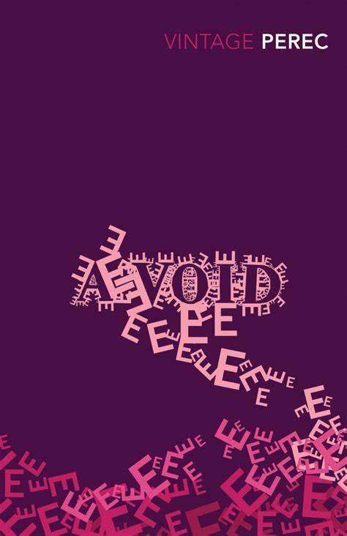
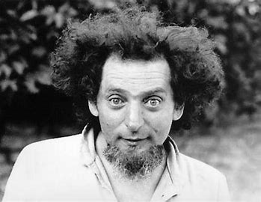
The Oulipo
(Ouvroir de littérature potentielle – workshop of potential literature)
Queneau on Oulipians: ‘rats who construct the labyrinth from which they plan to escape.’

Slide 3
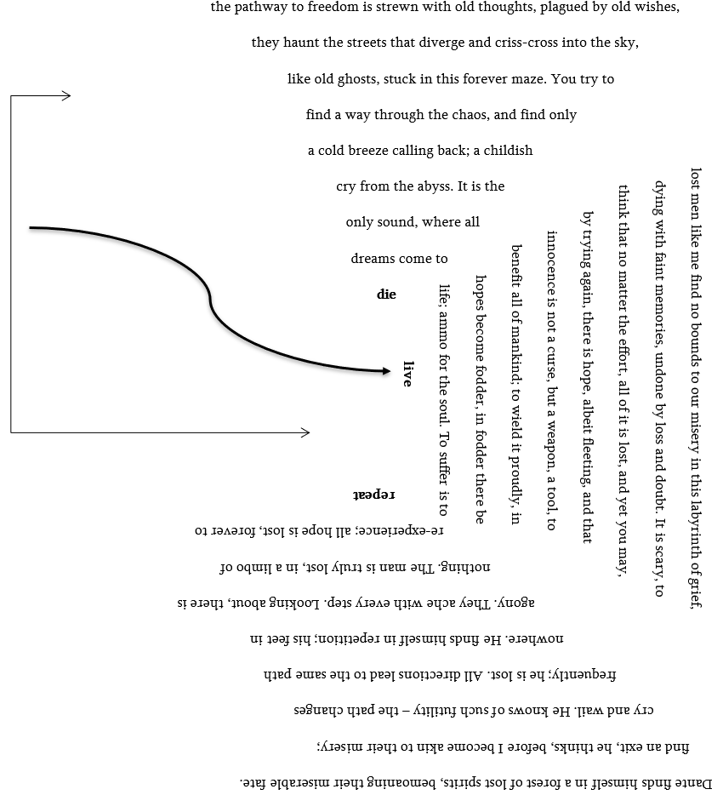
Infinity
Poem

Slide 4
Lipograms
To start, or not to start, thus doth our idiom:
If a toil in our mind is too irk-full
Facing slings ‘n’ shoots of confusing luck,
Or to don our valiant bows to yond storm
Thus, in by opposing, stub it. To pass—to nap,
Null; thus by kipping to say harsh nipping
A
E

Slide 5
Metrosexual + vampire = A tragic tale of mirrors and self-love
Dr Jekyll – Mr Hyde = Some random bloke
Lethargy + cocaine = Human equivalent of a jump start
Metrosexual + Mr Hyde = A dapper psychopath
Experiments in Equations
Trees (2Flames + RiverX) = Hangover (3Headaches + SweatX)
Neither trees nor a hangover will you want to meet while driving a car, so let’s cancel these out for now.
Next, let’s expand the brackets: 2Fire is plural, which would be flames. However, we want to divide. So, a fire is now a flame, singular. Then it is 3Headaches, which is plural again.

Slide 6
Boro Gatsby ando Roma Pogadi Jib
In me yunner an moor vunabble yeers me farther gay me soom that I bin ternin oer in me mine efer sins.
“Wheever ye feel lite criteecising n one,” e tol me, “just member tha ool the peepu in this wurl aven ad tha vantages tha yoo add.”
E didn say ani moor boot we oolways bin unooshally cumooniative in e reserf kina way, en I understood tha men e gray deel moor than tha. En conseekwence I’m be uncline tu reserve ool judgemens, e abit tha as opennd op manee curous naytoors tu me an alsur may me tvictim o nay a fyu vetran boors

Slide 7
Why Write This / Why Publish It?
The value of our unique voices
  Personal psychological, creative, ethnic and cultural expression
  Our unique voices create unique forms of art
Creating an artistic portfolio
  Looks great on CV / You can boast about it at parties (be insufferable)
  Establish yourself as an artist; show the world what makes your work unique
  Makes your work available and accessible to an international audience; can be cited and studied by others

Slide 8
Paracrow Tute
(Thank you)

