Slide 1
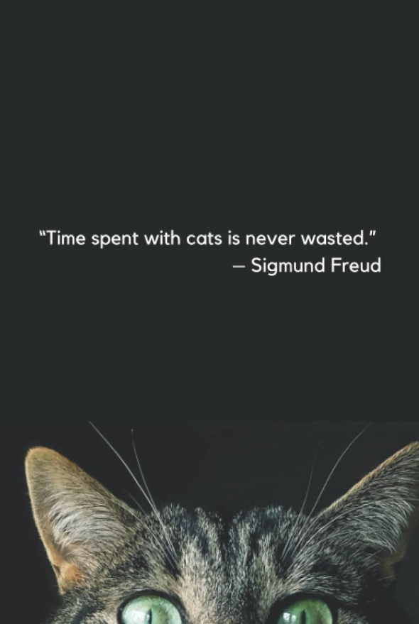

Slide 2
Feline Ownership and Well-Being During COVID-19 Mandated Lockdowns
Presented by Marc Viau, MSc Psychology
University of Essex Online
for
The Second Annual Essex Student Journal Conference

Slide 3
Introduction
Extant literature on how pet ownership impacted individuals’ well-being during the global COVID-19 pandemic is inconsistent and broad in scope.
Long-term psychological impact of COVID-19 yet fully understood (Adorjan and Stubbe, 2023)
Some studies report positive impact of pet ownership and others report a null or negative impact.

Slide 4
Introduction
Noticeable spike in pet ownership during early days of the pandemic (Ho, Hussain and Sparagano, 2021); however,
  Uncertainty regarding whether pets could act as a mitigating factor against any negative psychological effects; and,
  Extent to which pet ownership had an impact on well-being during periods of COVID-19 mandated self-isolation.

Slide 5
Introduction
Research Question:
  “How did cat owners perceive their relationship with their cats, and whether this affected their general sense of well-being during periods of COVID-19 mandated lockdowns?”

Slide 6
Introduction
This case study (n = 1):
  Explored lived experience of cat owners and how cat ownership affected their sense of well-being during periods of COVID-19 isolation.
  Revealed impact on participant’s well-being was mostly positive and the result of assuming the role of attachment figure.
Results can further our understanding of how cats can help individuals cope with prolonged periods of social isolation.

Slide 7
Method

Slide 8
Design
Qualitative case study
Semi-structured interview
Phenomenological perspective to explore the participant’s lived experience

Slide 9
Procedure
Participants: n = 1 recruited using purposive sampling
20-minute, in-person, semi-structured interview consisting of five questions
Recording transcribed using an online automated transcription service
Transcript checked against recording for any errors or inconsistencies and corrections applied as necessary

Slide 10
Ethics
Participant given a Participant Information Sheet ahead of the interview
Completed a Participant Consent Form to obtain informed consent
Shown a Debriefing Form and given an opportunity to voice any concerns with the researcher following interview
Study in accordance with CPA’s Code of Ethics for Psychologists (2018) and BPS’s Code of Human Research Ethics (Oates et al., 2021)
Anonymous and confidential
Ethical approval obtained from UoE

Slide 11
Analysis
  Interpretive Phenomenological Analysis (IPA) of interview transcript per Pietkiewicz and Smith (2014)
  Iterative process involved familiarisation of the interview data through repeated readings transcript
  Initial exploratory comments recorded in transcript’s left-hand margin
  Emergent themes then recorded in right-hand margin
  Similar themes clustered together, and finally organised into superordinate and subordinate themes
  Some data approached through the theoretical lens of Bowlby and Ainsworth’s attachment theory (Bowlby, 1979)

Slide 12
Results
Table 1
Summary of Superordinate and Subordinate Themes
Superordinate Theme | Subordinate Theme | Example Quote
Assuming the role of attachment figure | Approximation of parent-child relationship. Taking on the role of caregiver. | “I think it's possible or even maybe likely that my being there more often, sort of increased their attachment to me.”
Benefits to the participant | Sense of fulfilment. Positive mental health benefits. | “I still kind of feel as much of a fulfilment from the relationship I have with my pets.”
Benefits to cats | Fostering attachment. Impact on cats' well-being. | “I think they would be more attached now.”

Slide 13
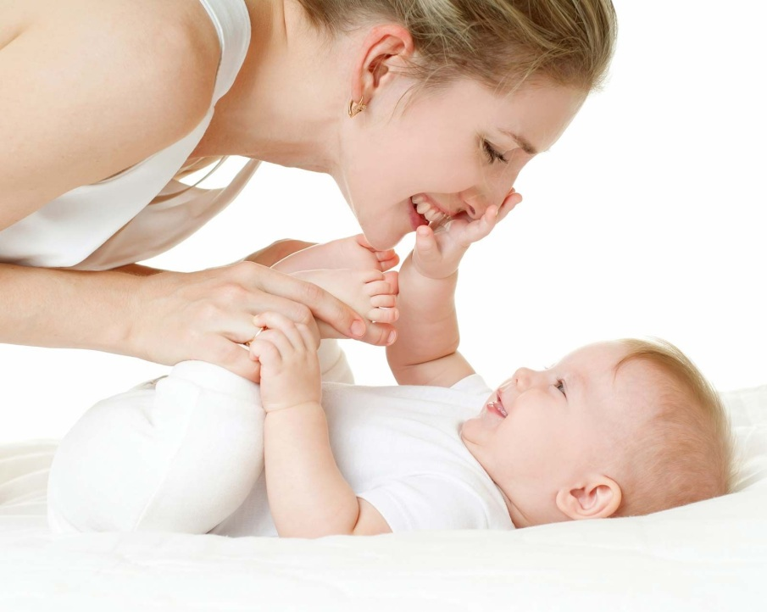
Assuming the role of attachment figure
  Attachment figure:
    Refers to those to whom infants become attached in their formative years (Sherman, Rice and Cassidy, 2015)

Slide 14

Approximation of parent-child relationship
  “In general, I would say I have a close relationship with my cats. I don't have children, but I suppose it might be similar to a parent-child relationship, without necessarily, I mean, acknowledging that it's not the same.”

Slide 15
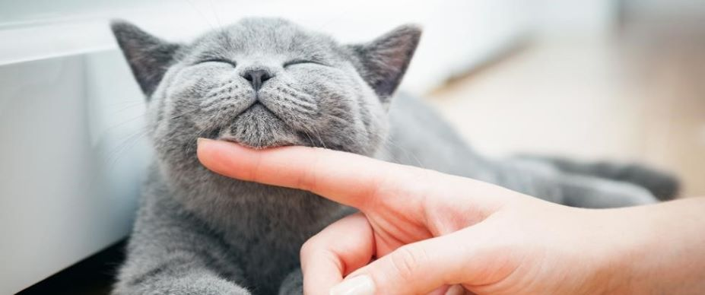
Taking on the role of caregiver
  “I take care of them, take them to the doctor, when they need it, and, yeah, all that kind of stuff. And I provide a home for them. And I also provide love to them, which in my opinion is something that a parent should provide to a child.”

Slide 16
Benefits to the participant
Benefits to well-being during the pandemic chiefly derived from acting as a caregiver

Slide 17
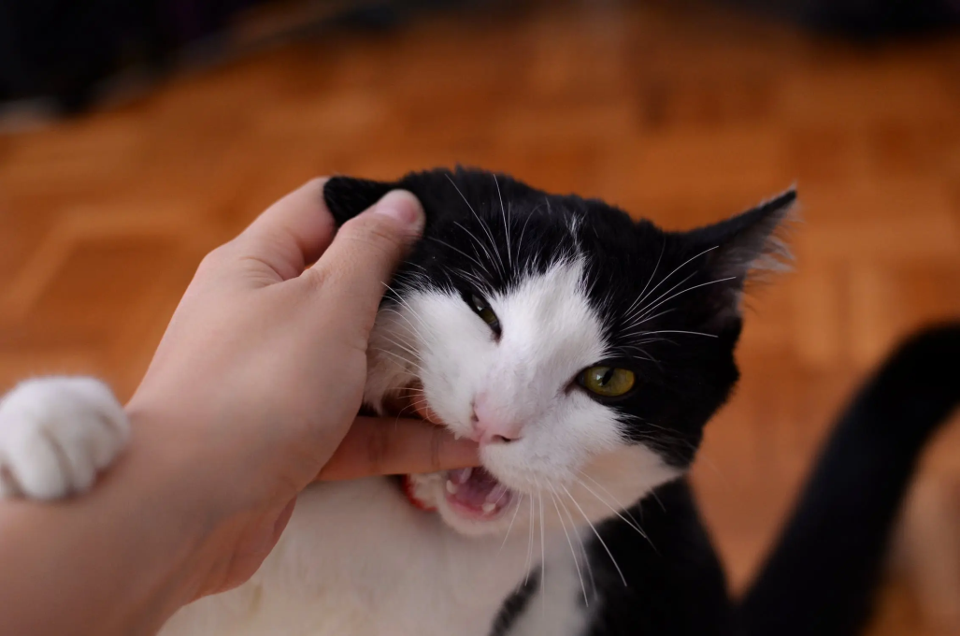
Sense of fulfillment
  “I suppose it just provides a sense of appreciation of yourself, like, maybe even as fundamental as, like, your existence just being acknowledged and appreciated, not ignored or more rejected or something like that.”

Slide 18
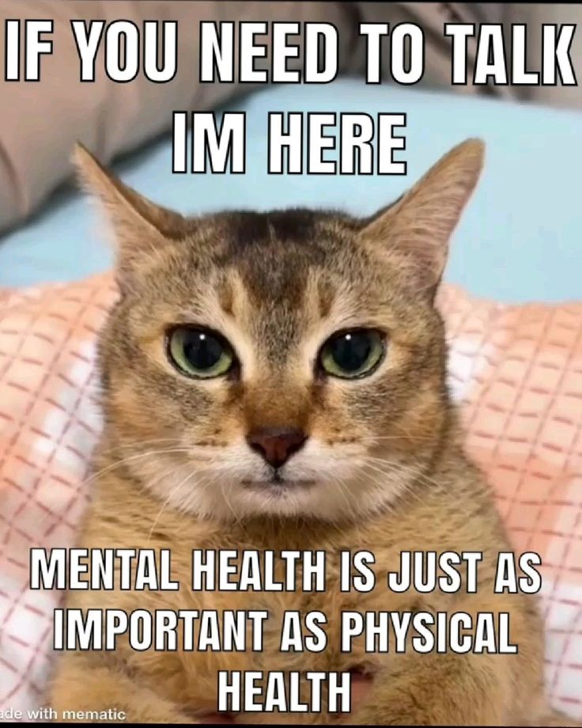
Positive mental health benefits
  “It probably is very important for mental health, staves off depression probably, and,
  yeah, I don't know. Yeah.”

Slide 19
Benefits to cats
Participant working from home during pandemic seen as benefit to himself and cats

Slide 20
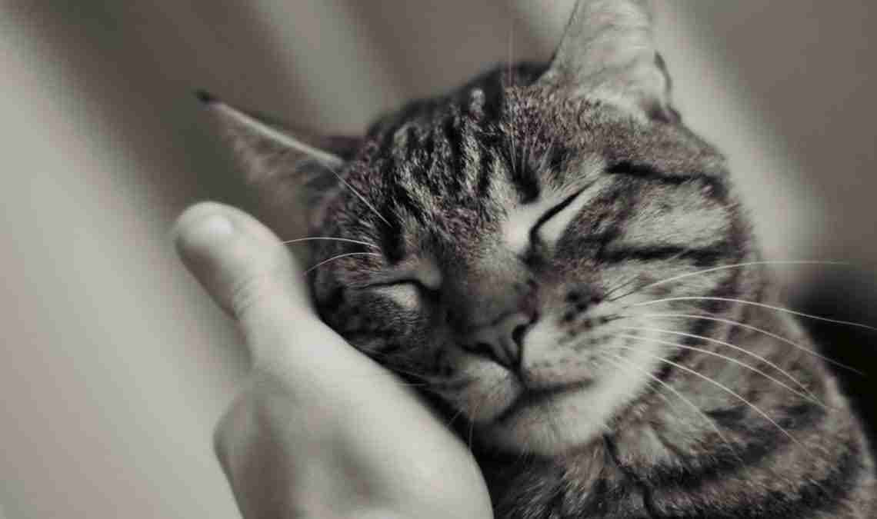
Fostering attachment
  “Since the pandemic, I'm at home a lot more, and they're more affectionate or they're closer or they're… they seem more attached.”

Slide 21
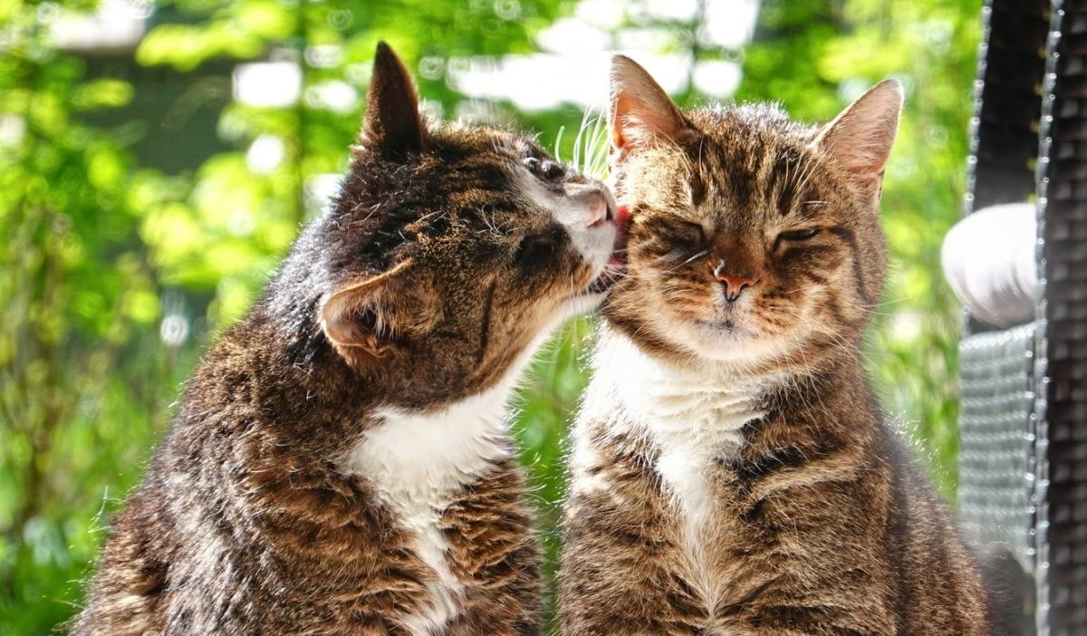
Impact on cats’ well-being
  “I think COVID benefited my cats because I was at home more with them to be able to interact with them and take care of them, you know, throughout the week.”

Slide 22
Discussion
Cats can form bonds with their caregivers in a similar fashion to that of children to their attachment figures
Close relationships contribute positively to psychological well-being
Lockdowns afforded a greater opportunity to amplify the role of caregiver
Introversion impacted positively on psychological well-being during the pandemic.

Slide 23
Conclusion & limitations
This study provided a rich account of one individual’s lived experience; however,
  Findings difficult to be more broadly generalisable.
  IPA is by definition dependent on the researcher’s subjective interpretation.

Slide 24


Slide 25
References
Adorjan, K., & Stubbe, H. C. (2023). Insight into the long-term psychological impacts of the COVID- 19 pandemic. European Archives of Psychiatry and Clinical Neuroscience, 273(2), 287–288. https://doi.org/10.1007/s00406-023-01599-6
Bowlby, J. (1979). The Bowlby-Ainsworth attachment theory. Behavioral and Brain Sciences, 2(4), 637–638. https://doi.org/10.1017/S0140525X00064955
Canadian Psychological Association. (2018, January 29). Code of Ethics for Psychologists. https://cpa.ca/aboutcpa/committees/ethics/codeofethics/
Ho, J., Hussain, S., & Sparagano, O. (2021). Did the COVID-19 Pandemic Spark a Public Interest in Pet Adoption? Frontiers in Veterinary Science, 8. https://doi.org/10.3389/fvets.2021.647308
Oates, J., Carpenter, D., Fisher, M., Goodson, S., Hannah, B., Kwiatkowski, R., Prutton, K., Reeves, D., & Wainwright, T. (2021). BPS Code of Human Research Ethics (p. bpsrep.2021.inf180). British Psychological Society. https://doi.org/10.53841/bpsrep.2021.inf180
Pietkiewicz, I., & Smith, J. A. (2014). A practical guide to using Interpretative Phenomenological Analysis in qualitative research psychology. Czasopismo Psychologiczne Psychological Journal, 20(1). https://doi.org/10.14691/CPPJ.20.1.7
Sherman, L. J., Rice, K., & Cassidy, J. (2015). Infant capacities related to building internal working models of attachment figures: A theoretical and empirical review. Developmental Review, 37, 109–141. https://doi.org/10.1016/j.dr.2015.06.001

