Slide 1
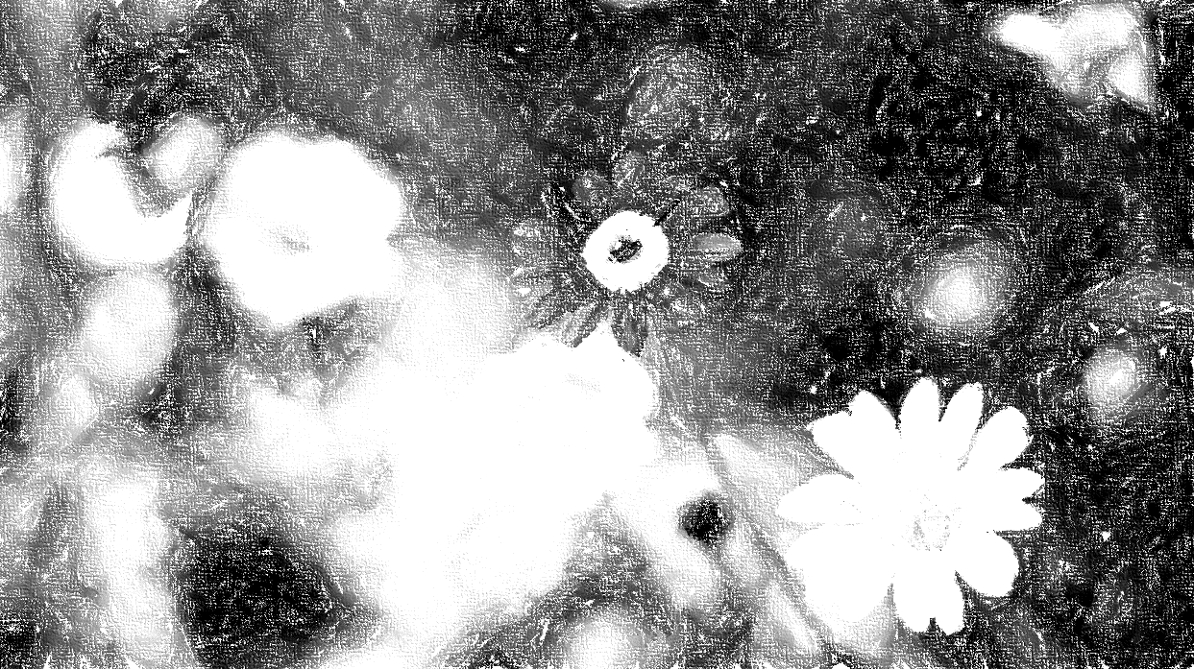


My Time will come…
Nasima Rahman

Slide 2

My journey as a writer
Journaling
Short stories
poems
Notes:
Journaling – helped me to gather my thoughts, feelings, experiences, and general observations. Helped me with reducing stress and anxiety, gain clarity on decisions/emotions, track personal growth over time and document memories/meaningful moments.
Journaling can act like a mirror, reflecting on your inner world. Over time, it helps you notice patterns, understand yourself better, and heal from things you didn’t even realise you needed healing.
Journaling is like a form of therapy, a creative outlet, a mental detox, or a way to slow down in a fast-paced world.
Short stories – developed from my journaling and dreams. These were more focused on a particular moment, which usually had some sort of twist or revelation. I would then sit with that and reflect.
Poems – this is where I turned my reflection into deep messages underlined with my truth and highlighting my state of mind. They push you to imagine how the experience may have been

Slide 3
My publishing journey
In my dreams
University of Essex
Published
Notes:
In my dreams – I never thought about publishing because I never thought I had a place in that part of the world. You see, growing up, the books I read had white characters, storylines which I couldn’t relate to, and all written by white writers.
University of Essex – Freshers week, I visited the stand with my dear friend Madiha. I remember being told the Essex Student Journal will start accepting creative writing soon. I just remember walking away thinking its nice that students will have the opportunity to have their work published.
Published - A few months later, I saw the email with this opportunity and submitted one of my pieces. I had not heard anything for a while and forgot about it. Until I receive a ‘congratulations’ email. I seriously could not believe this because I have no experience in “writing”, and to top that up, I am dyslexic. It was an emotional journey because I could finally see a bridge to close the gap of the barriers created by society. And this led me to write my following poem, which is what I will be talking to you about.

Slide 4
My time will come….
    Background/inspiration
    I remained silent about the discrimination I faced in placement, which many others experience daily. I decided I couldn't stay quiet any longer and combined people's experiences to create one powerful voice.
    I wrote this poem to raise awareness, and to stop the continuous discrimination healthcare practitioners face, in trying to save lives

Slide 5

My time will come….
    There you go, you have it all in writing,
    this will help you be like the rest of us,
    so, there should be no more nail biting.
    Come on you, it’s time to get on the bus.
    You are expected to feel liberated,
    but the shape on your face looks puzzled,
    the feeling of just being migrated,
    BREATH, you are finally unmuzzled.
    I am one of them, a sense of belonging,
    so, use your A+ and stop worrying.
    After all this time, why is it prolonging?
    It’s almost like you want me ferrying.
    Just as the sun goes down, and the moon shines bright,
    I will keep rising, as long as there is light!
Notes:
Haiku – my version – because rules are there to be broken!
Picture – At the top of Jabal al-Noor mountain in Mecca, Saudi Arabia, the Prophet Muhammad (pbuh) meditated and received his first revelation, "Iqra." This is the first verse of the Qur'an, which translates to 'read.’ I chose this picture because it represents “I will keep rising, as long as there is light”.

Slide 6
impact of Research and Publishing
Research and publishing transform students into scholars, ideas into influence, and effort into legacy
Builds confidence and identity
Develop my communication and writing skills
Start a data collection research project
Unexpected Opportunities (like this conference)
Publishing a poem shows that a student chose to speak. And in a world where many stay silent, that’s a bold, meaningful step.

Slide 7

Thank you
Nasima Rahman
nasimarahman@hotmail.co.uk

