Slide 1
Risk and Competition and its indirect effect on the observed gender gap in labour market
Author: Akshana Ravikumar
NB: Some of the images in this presentation have been changed from the original to ensure compliance with copyright regulations.
Except where otherwise noted, this work by Akshana Ravikumar is licensed under a Creative Commons Attribution 4.0 International Licence.

Slide 2
Aims of this research:
Identify factors causing the observed gender differences in taste and risk in the labour market in the UK
Comparison of statistical data between 2021 and 2024 to identify change in employment rate and identify factors affecting this
Does gender determine risk & competition?

Slide 3
What is Risk Averse?
Notes:
definition: people who prefer outcomes with low uncertainty to those outcomes with high uncertainty

Slide 4
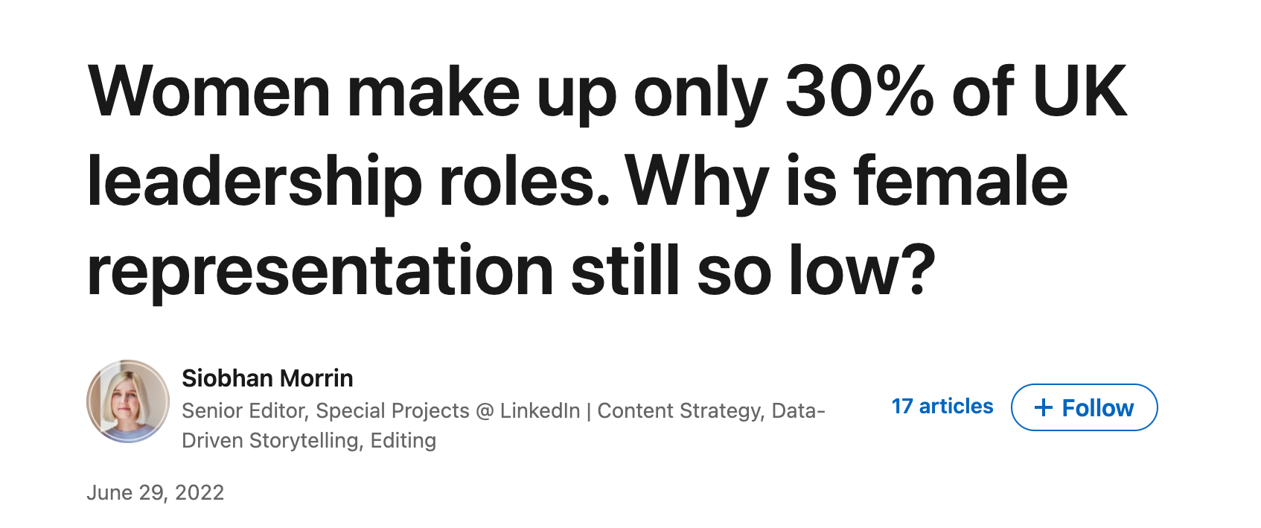
Factors causing gender differences in risk & competition:
Low representation in higher-level positions than men (glass-ceiling effect)
Lack of flexibility in higher roles that support lifestyle choices e.g. home working, flexible hours, childcare service
Covid-19 (Direct & Indirect Effect)
Notes:
Contrasting argument: (Clot, Giusta and Razzu, 2020) where they observed 115 professionals found results showing how women did not ‘shy away from competition and performed as well as men’. They did not find a disparity in the performance between men and women. Women performed just as well or better as men
Link first two bullet points: lack of female representation in media/male dominated work forces but also evidence shows that women seem less likely to take on roles that are inflexible once they have children. Thus being more risk-averse widens the existing gap in the labour market for women

Slide 5
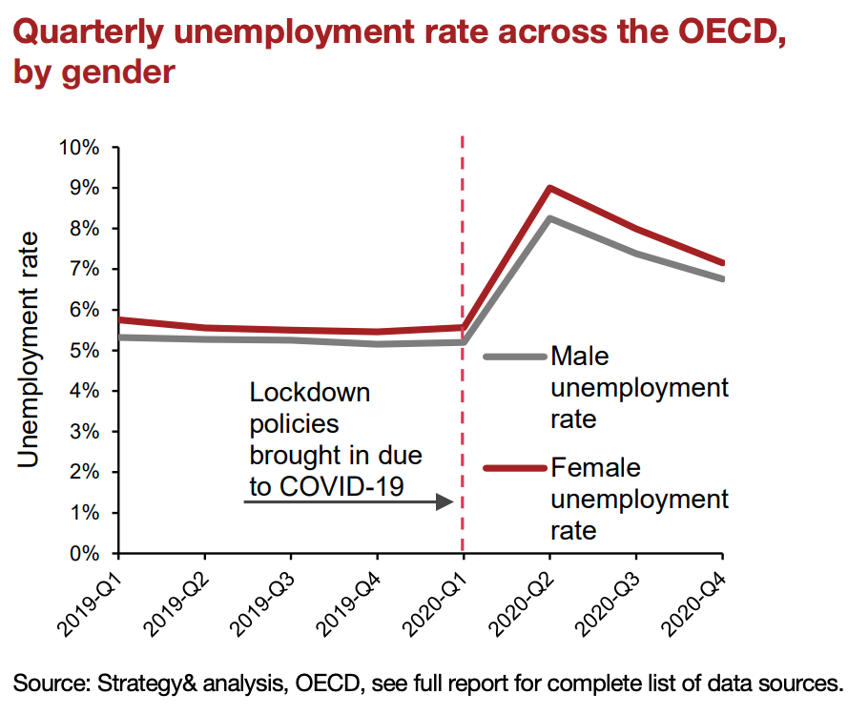
COVID-19 impact on Female Labour

Slide 6
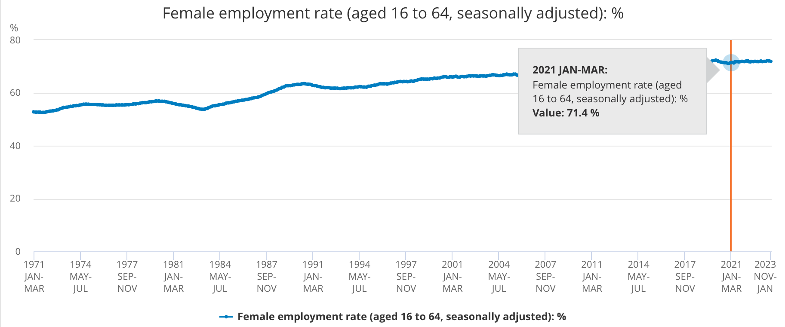
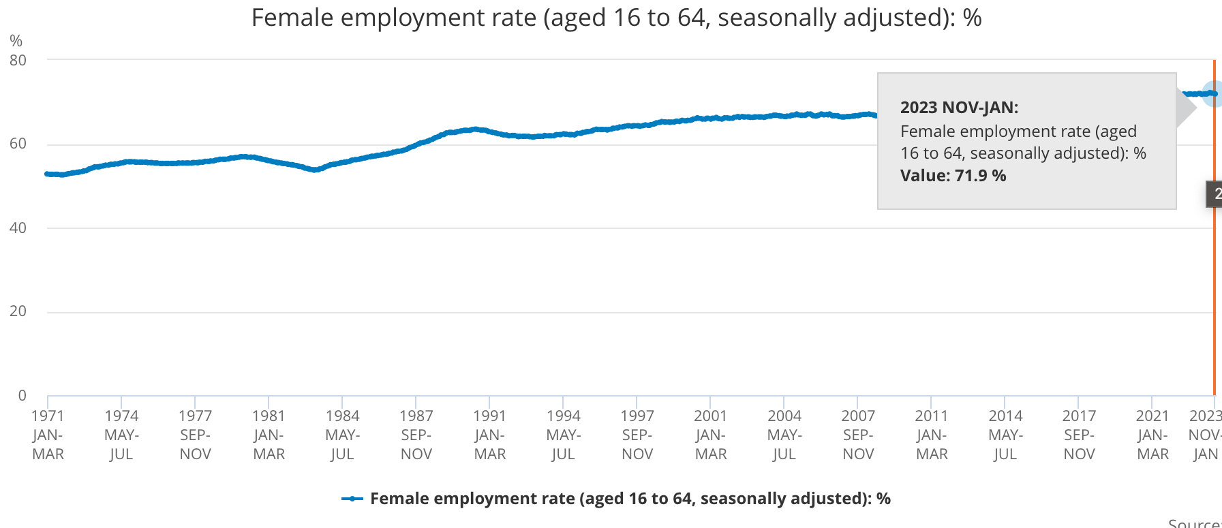
Graphs highlighting impact on female labour
2021, Female employment = 71.4%
2023-2024, Female employment = 71.9%.
Notes:
Comment on only a slight increase of 0.5% could be due to improved flexibility in work force.
Gender explains only a very small fraction of the variance in risk attitudes, and finding such differences depends on the method used to elicit the risk preferences. Thus, further research is needed to understand under what conditions women behave in a more risk-averse manner than men. It is more individual based (circumstances vary)

Slide 7
ESJ experience
The Global Undergraduate Highly Commended Award for Economics with over 2000 entries
Published 2 academic papers & current Reviewer
Opportunity at ESJ Conference
Improve Public Speaking & Confidence

