Slide 1
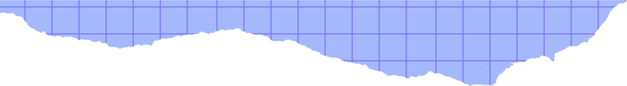


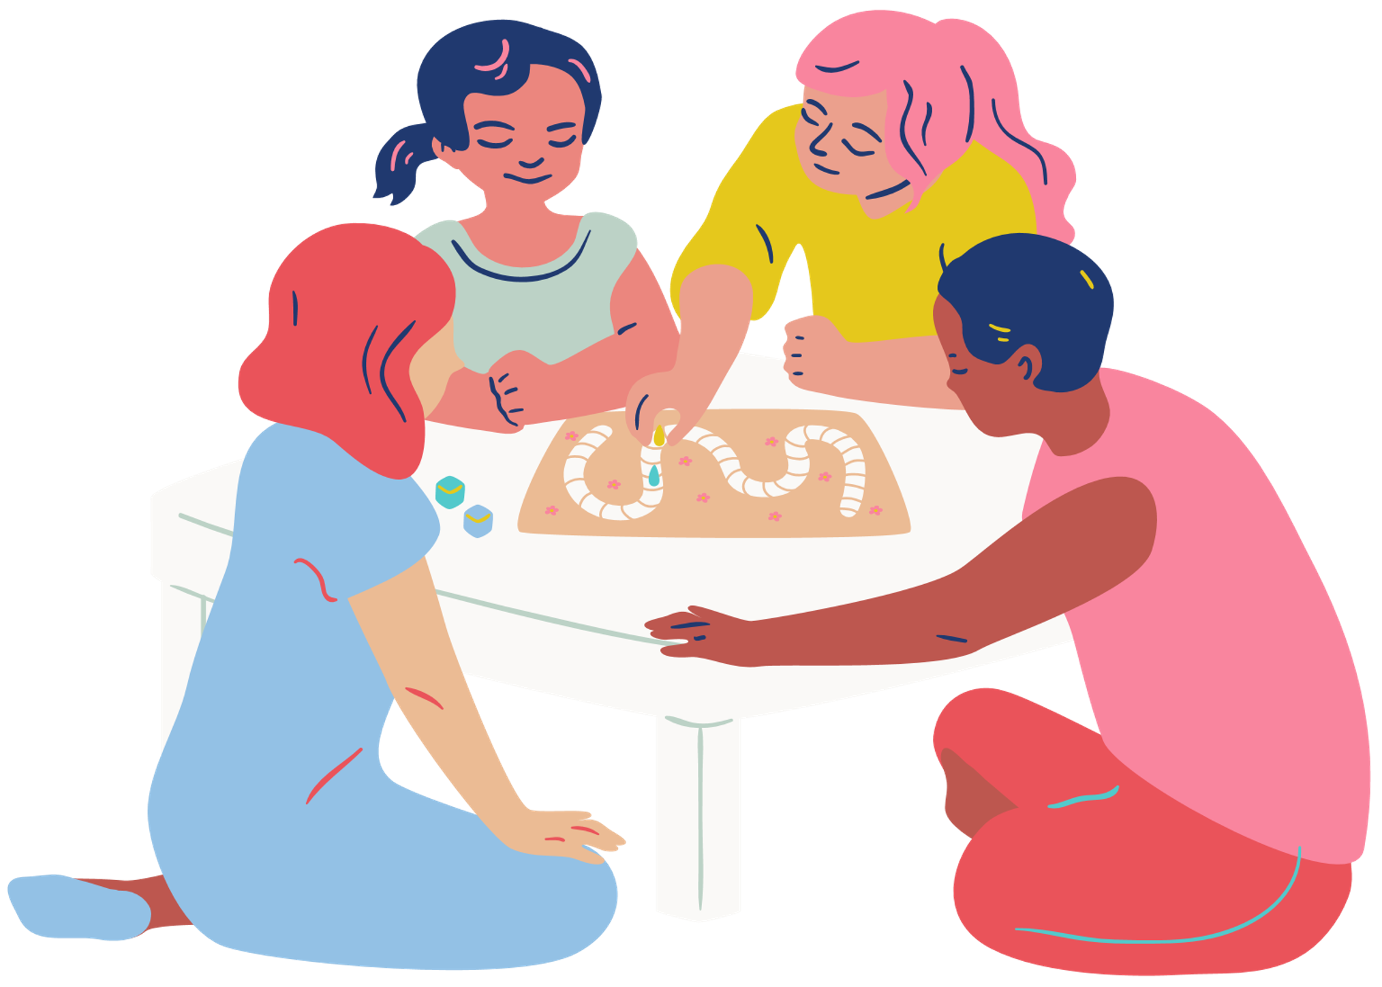
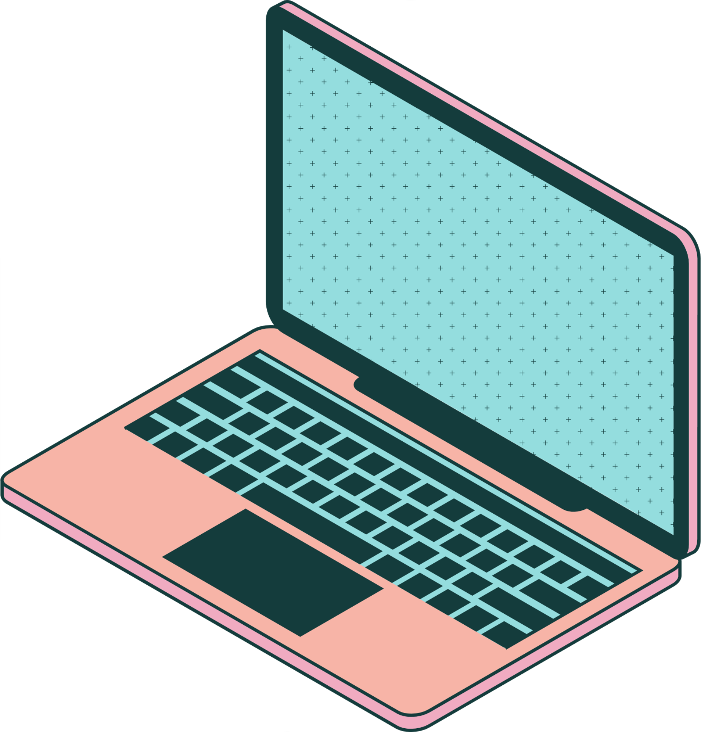
Redefining the digital divide
By Mawadah Nofal
Redefining the Digital Divide
Except where otherwise noted, this work by Mawadah Nofal is licensed under a Creative Commons Attribution 4.0 International Licence.

Slide 2
The Network Society
Global
The Network Society
Networked
Informational

Slide 3
What is the digital divide?
What is the Digital Divide?
Term used to describe an individual, institution, or group of people’s lack of access to digital information and tools.

Slide 4
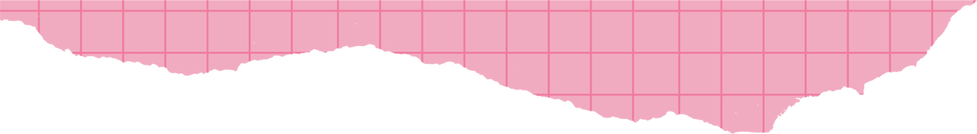


What causes the digital divide?
Due to...
  Race
  Gender
  Class
  Culture
  Geography (North/South Divide)

Slide 5
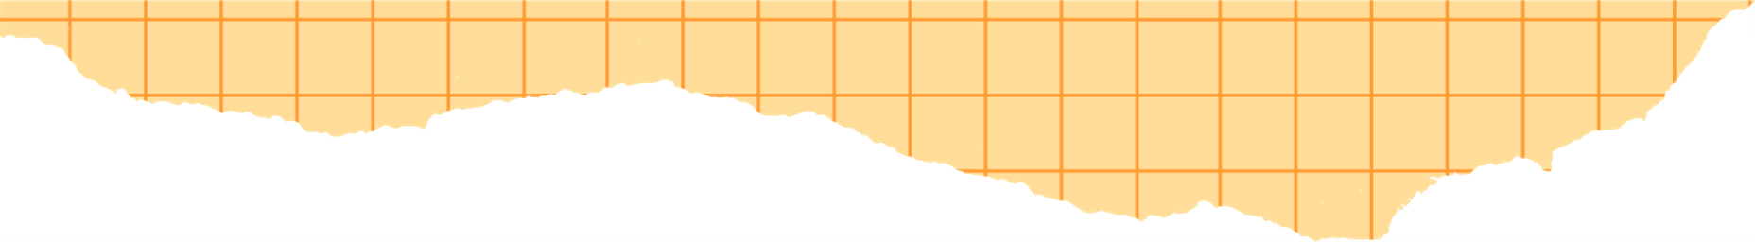

Why redefine it?
Why redefine?
While we all deserve access to technology, the current definition of the Digital Divide ignores deeper strucutral enqualities and overlooks the need for digital literacy, tools and education to proccess information and a culture where everyone is safe and supported in those journeys.
The traditional definition of the digital divide fails to capture the depth of inequity and its consequences socially, economically, culturally, and academically for groups that are already traditionally marginalised.

Slide 6



Key factors
The Divide during the Pandemic
A Hostile Digital World
Gender Divide

Slide 7


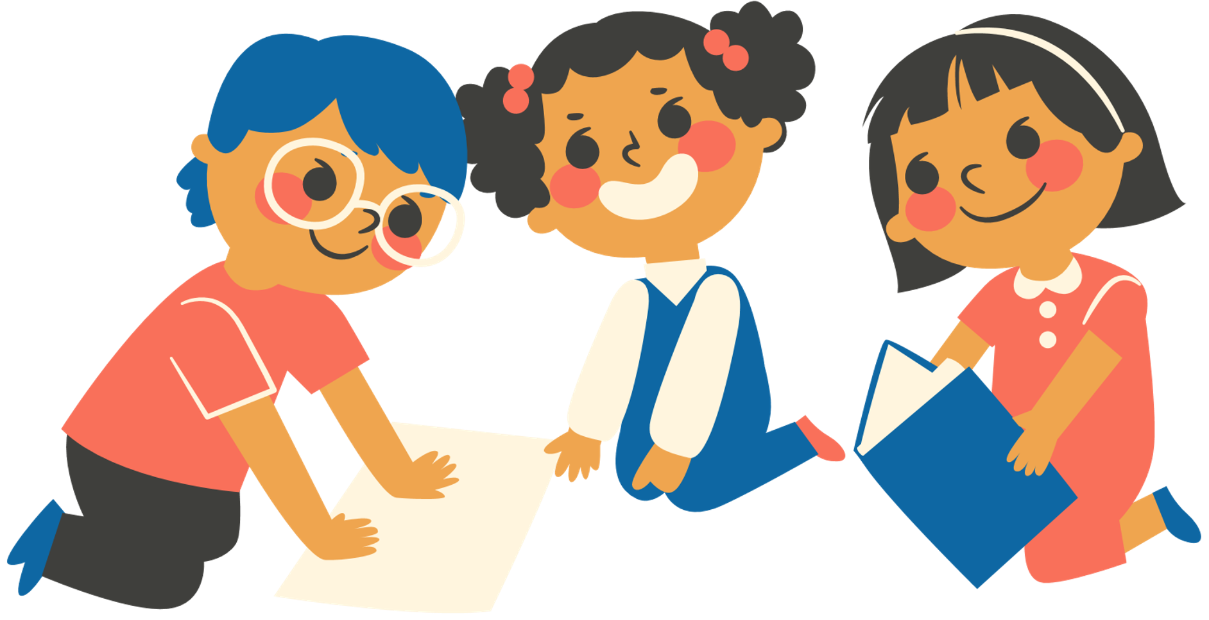
The Gender Divide
The Gender Divide

Slide 8


A hostile digital world
Not a
Safe Space
we must expand the idea of access to demand access of a non-hostile and inclusive digital world

Slide 9
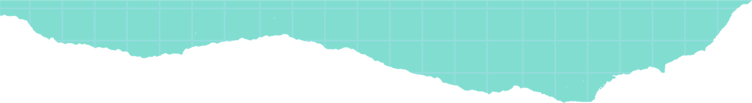
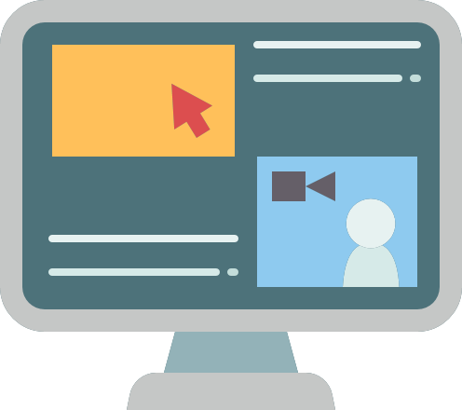

The divide during Covid-19
The Divide during Covid-19

Slide 10
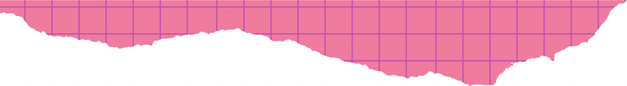
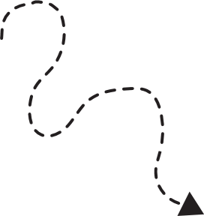


Conclusions
CONCLUSIONS
CONCLUSION 1
CONCLUSION 2
CONCLUSION 3
We need to create safer and more equitable information journeys
we need to address digital illiteracy and the power imbalances caused by those who generate and control information to guarantee the quality of information being accessed and that everyone is given the tools to decode and utilise it.
we need to change the definition of the Digital Divide to reflect the structural issues in the flow of information that keeps so much of the population in information poverty.

