Slide 1

Racism in America
RACISM IN
AMERICA
NB: Some of the images in this presentation have been altered from the original to ensure compliance with copyright regulations.
Except where otherwise noted, this work by Louis Mitchell is licensed under a Creative Commons Attribution 4.0 International Licence.

Slide 2
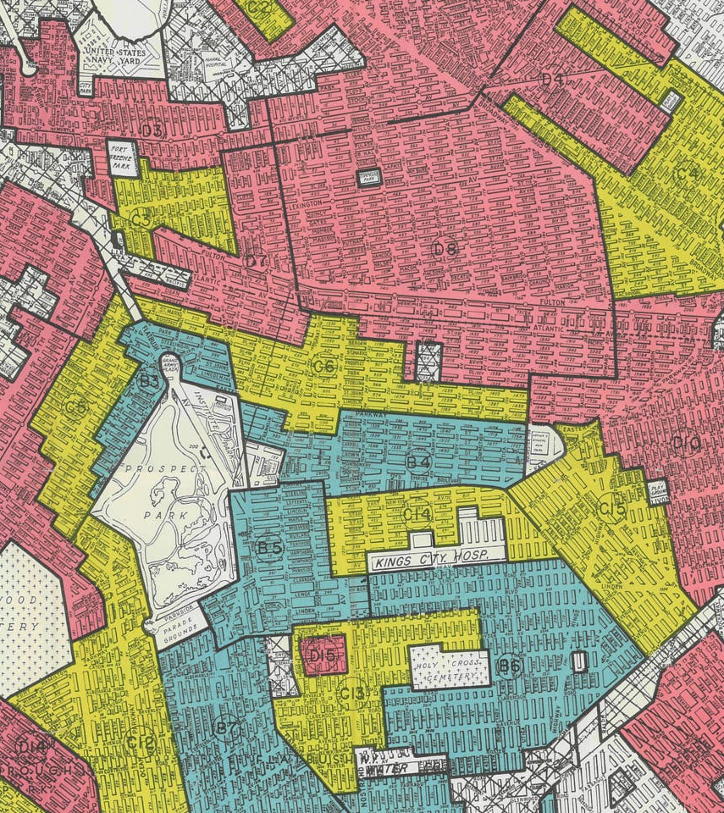
Wealth Accumulation
Wealth Accumulation
The median wealth of white households in 2013 was $141,900, while for black households it was only $11,000
Discriminatory housing laws and practices
  The Federal Housing Administration
  Real estate agents
  Banks
In 2007 home equity made up 71% of total wealth for black homeowners compared to 51% for white homeowners,

Slide 3
Education
Education
Segregated schools between 1849 and 1954
Underfunded schools and universities
In 2020, 51.6% of college students were white, whereas only 12.5% of students identified as black

Slide 4

Income Inequality and Workplace Discrimination
The median income for white households in the United States was $84,110, while for black households it was only $52,080
Black applicants are less likely to be hired (Pager, 2009)
African Americans earn less for the same job in comparison to their white counterparts (Black, 2006)
A darker skin tone lowers earning potential (Bailey, 2014).
Black individuals are less likely to be promoted and more liable to experience workplace harassment and discrimination (Pager, 2008).
Notes:
Poor education in Black communities has had a profoundly negative effect on household income. In 2021, the median income for white households in the United States was $84,110, while for black households it was only $52,080

Slide 5
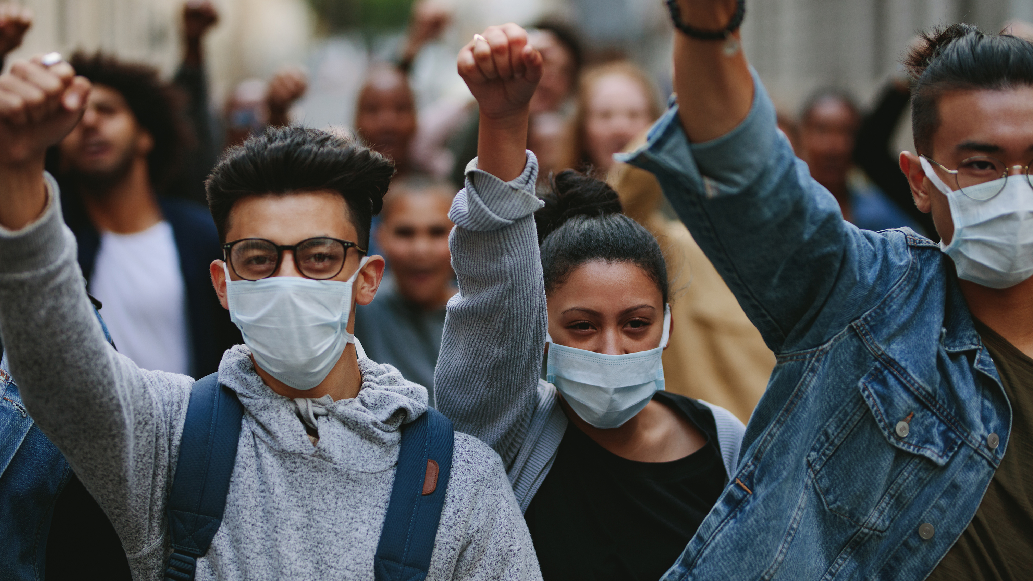
Police Brutality
Mistrust and fear of law enforcement make it difficult for people to report crimes and worsen the relationship between the black community and the police (Dr Alexandra Cox, 2023).
Studies have shown that Black people are 2.8 times more likely to be met with lethal force despite being unarmed than white people (Njoku, 2021).
The trauma and loss experienced by families and communities can lead to increased rates of mental health issues and the propagation of poverty (Bor, 2018).
African American adults are 5.9 times more likely to be incarcerated than white persons and, in turn, are more likely to be denied bail or have a higher bond set (Report to the United Nations 2018).

Slide 6
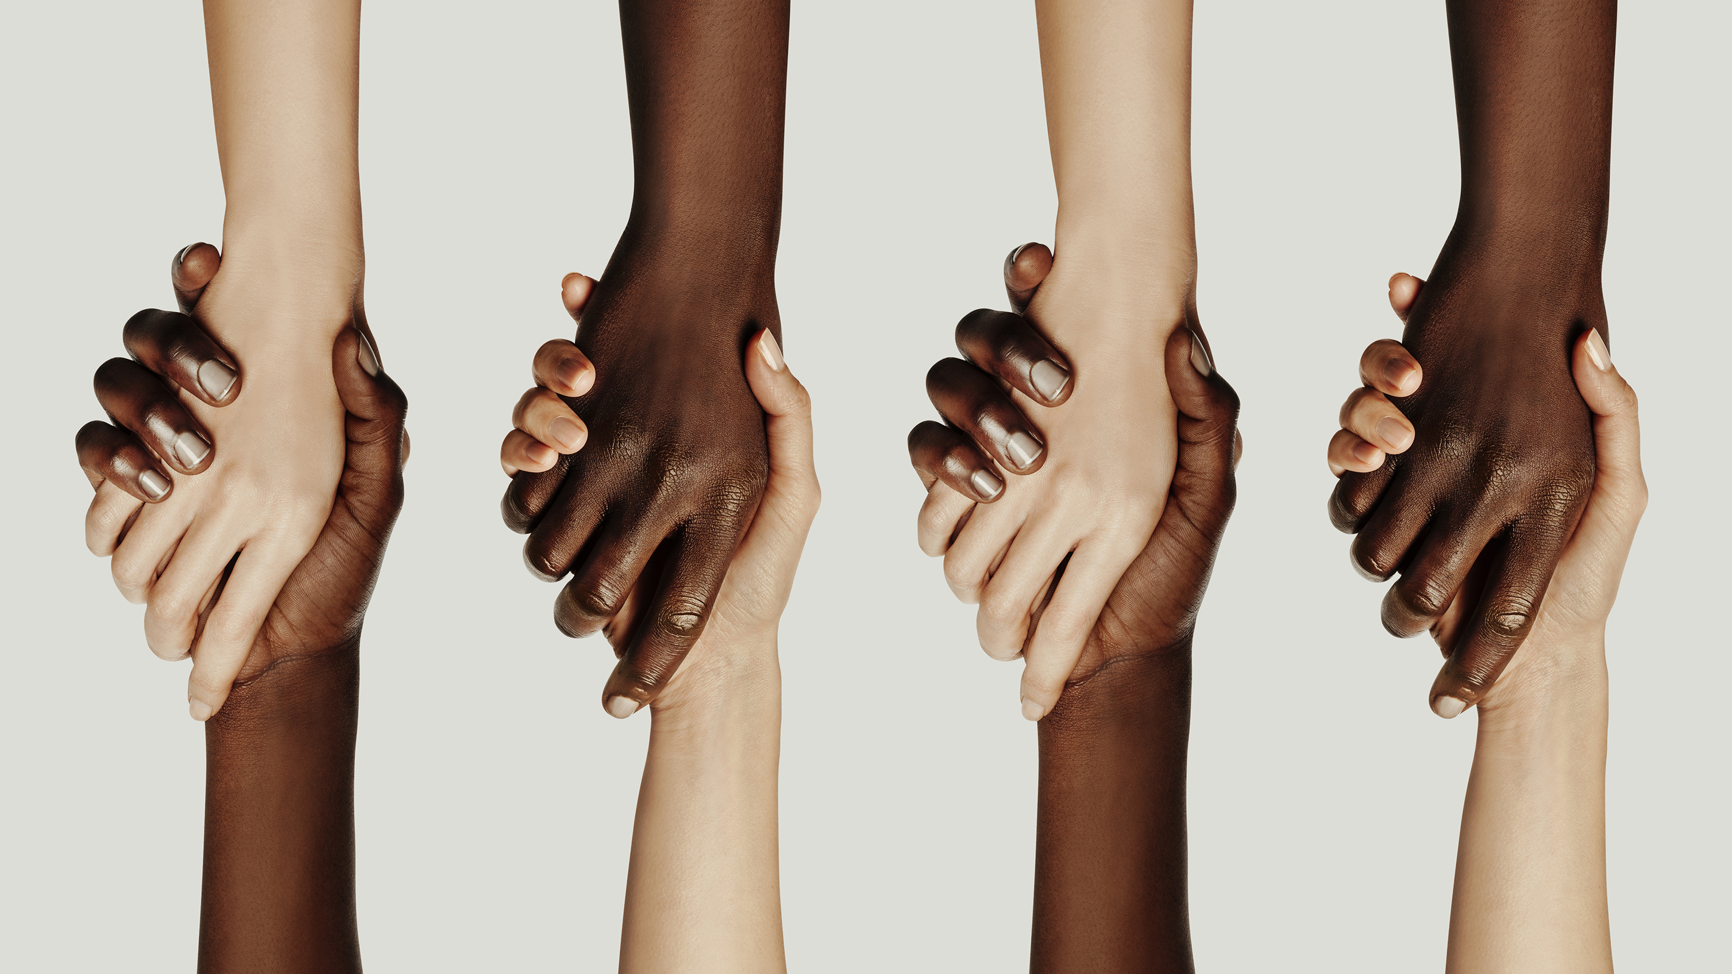
Discussion

