Slide 1
Intro slide
Essex Student Journal Conference
Wednesday 1 May 2024
12 pm – 2 pm

Slide 2

Welcome
Welcome
Kimia Aghasoleimani, Student Journal Editor

Slide 3
Celebrating the editors
Celebrating the current and former Student Journal Editors
Kimia Aghasoleimani 2023-present
Aisyah Shamshum 2022-2023
Dafni Kalatzi Pantera 2021-2022
Sara Sheriff 2021
Lina Abdelhafiz 2019-2020

Slide 4
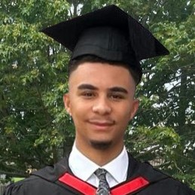
Louis Mitchell, Racism in America
Louis Mitchell
Racism in America

Slide 5
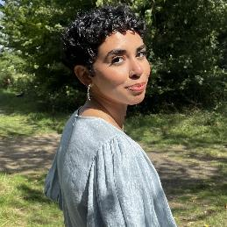
Mawadah Nofal, Redefining the digital divide
Mawadah Nofal
Redefining the digital divide

Slide 6
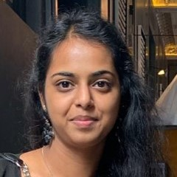
Akshana Ravikumar, Risk, competition, and the gender gap
Akshana Ravikumar
Risk and competition and its indirect effect on the observed gender gap in the labour market

Slide 7
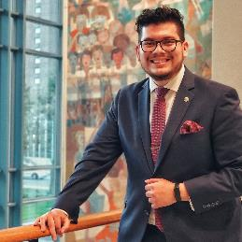
Pablo Soriano Mena, The declining labour share of income across the globe
Pablo Soriano Mena
The declining labour share of income across the globe

Slide 8
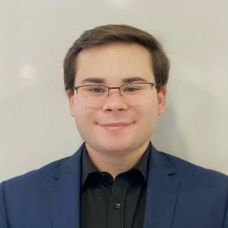
Luke Wheeler, Why is cancer so hard to cure?
Luke Wheeler
Why is cancer so hard to cure?

Slide 9
Insights from Jon White
Insights from Jon White
Director of Library and Cultural Services

Slide 10
Closing remarks
Closing remarks
Kimia Aghasoleimani, Student Journal Editor

Slide 11



Contact details
Find out more:
publications.essex.ac.uk
Contact the team:
journal@essex.ac.uk
@Essex_SJ
Join us now for
pizza, cakes, and discussion

